Slide 1
SIGNALS AND DAEMON PROCESSES
Divya Jennifer Dsouza
NMAMIT,Nitte

Slide 2
Signals are software interrupts. Signals provide a way of handling asynchronous events: a user at a terminal typing the interrupt key to stop a program or the next program in a pipeline terminating prematurely.

Slide 3
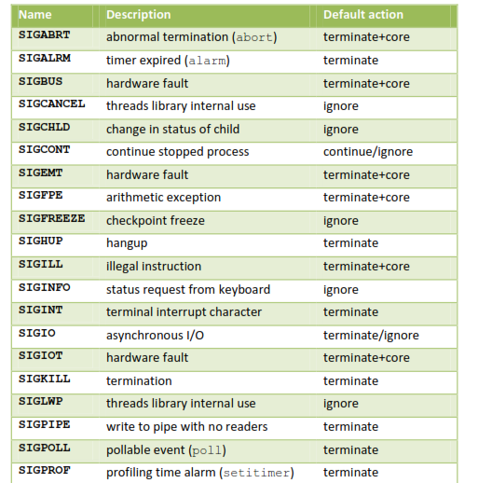

Slide 4
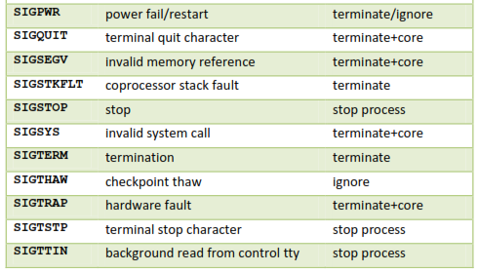
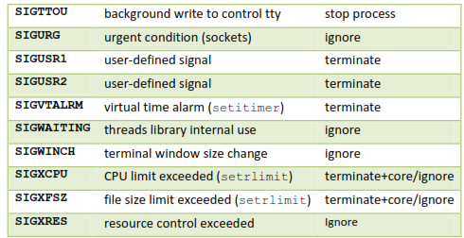

Slide 5
When a signal is sent to a process, it is pending on the process to handle it. The process can react to pending signals in one of three ways:
Accept the default action of the signal, which for most signals will terminate the process.
Ignore the signal. The signal will be discarded and it has no affect whatsoever on the recipient process.
Invoke a user-defined function. The function is known as a signal handler routine and the signal is said to be caught when this function is called.

Slide 6
THE UNIX KERNEL SUPPORT OF SIGNALS
When a signal is generated for a process, the kernel will set the corresponding signal flag in the process table slot of the recipient process.
If the recipient process is asleep, the kernel will awaken the process by scheduling it.
When the recipient process runs, the kernel will check the process U-area that contains an array of signal handling specifications.
If array entry contains a zero value, the process will accept the default action of the signal.
If array entry contains a 1 value, the process will ignore the signal and kernel will discard it.
If array entry contains any other value, it is used as the function pointer for a user-defined signal handler routine.

Slide 7
Signals
The function prototype of the signal API is:
#include <signal.h>
void (*signal(int sig_no, void (*handler)(int)))(int);
The formal argument of the API are: sig_no is a signal identifier like SIGINT or SIGTERM.
The handler argument is the function pointer of a user-defined signal handler function.

Slide 8
The following example attempts to catch the SIGTERM signal, ignores the SIGINT signal, and accepts the default action of the SIGSEGV signal.
The pause API suspends the calling process until it is interrupted by a signal and the corresponding signal handler does a return:

Slide 9
#include<iostream.h>
#include<signal.h>
/*signal handler function*/
void catch_sig(int sig_num)
{
signal (sig_num,catch_sig);
cout<<”catch_sig:”<<sig_num<<endl;
}
/*main function*/
int main()
{
}
signal(SIGTERM,catch_sig);
signal(SIGINT,SIG_IGN);
signal(SIGSEGV,SIG_DFL);
pause( ); /*wait for a signal interruption*/

Slide 10
The SIG_IGN specifies a signal is to be ignored, which means that if the signal is generated to the process, it will be discarded without any interruption of the process.
The SIG_DFL specifies to accept the default action of a signal.

Slide 11
SIGNAL MASK
A process initially inherits the parent’s signal mask when it is created, but any pending signals for the parent process are not passed on. A process may query or set its signal mask via the sigprocmask API:
#include <signal.h>
int sigprocmask(int cmd, const sigset_t *new_mask, sigset_t *old_mask);
Returns: 0 if OK, 1 on error

Slide 12
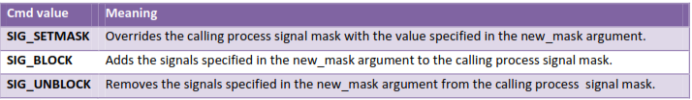
The new_mask argument defines a set of signals to be set or reset in a calling process signal mask, and the cmd argument specifies how the new_mask value is to be used by the API.
The possible values of cmd and the corresponding use of the new_mask value are:

Slide 13
✓ If the actual argument to new_mask argument is a NULL pointer, the cmd argument will be ignored, and the current process signal mask will not be altered.
✓ If the actual argument to old_mask is a NULL pointer, no previous signal mask will be returned.
✓ The sigset_t contains a collection of bit flags.

Slide 14
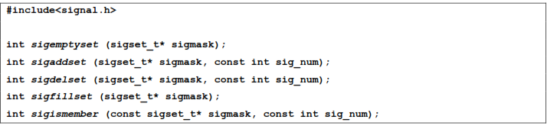
The BSD UNIX and POSIX.1 define a set of API known as sigsetops functions which set, reset and query the presence of signals in a sigset_t typed variable:

Slide 15
The sigemptyset API clears all signal flags in the sigmask argument.
The sigaddset API sets the flag corresponding to the signal_num signal in the sigmask argument.
The sigdelset API clears the flag corresponding to the signal_num signal in the sigmask argument.
The sigfillset API sets all the signal flags in the sigmask argument.
[ all the above functions return 0 if OK, -1 on error ]
The sigismember API returns 1 if flag is set, 0 if not set and -1 if the call fails.

Slide 16
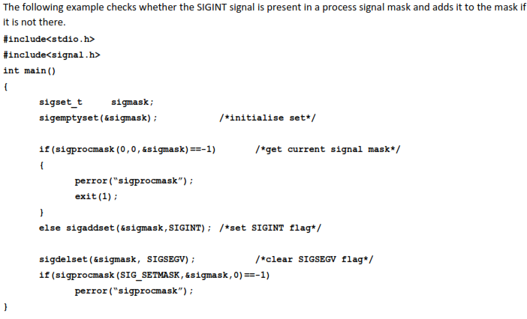

Slide 17
A process can query which signals are pending for it via the sigpending API:
#include<signal.h>
int sigpending(sigset_t* sigmask);
Returns 0 if OK, -1 if fails.
The sigpending API can be useful to find out whether one or more signals are pending for a process and to set up special signal handling methods for these signals before the process calls the sigprocmask API to unblock them.
The following example reports to the console whether the SIGTERM signal is pending for the process:

Slide 18
#include<iostream.h>
#include<stdio.h>
#include<signal.h>
int main()
{
sigset_t sigmask;
sigemptyset(&sigmask);
if(sigpending(&sigmask)==-1)
perror(“sigpending”);
else cout << “SIGTERM signal is:” << (sigismember(&sigmask,SIGTERM) ? “Set” : “No Set”) << endl;
}

Slide 19
UNIX also supports following APIs for signal mask manipulation:
#include<signal.h>
int sighold(int signal_num);
int sigrelse(int signal_num);
int sigignore(int signal_num);
int sigpause(int signal_num);

Slide 20
SIGACTION
The sigaction API blocks the signal it is catching allowing a process to specify additional signals to be blocked when the API is handling a signal.
The sigaction API prototype is:
#include<signal.h>
int sigaction(int signal_num, struct sigaction* action, struct sigaction* old_action);
Returns: 0 if OK, 1 on error

Slide 21
The struct sigaction data type is defined in the <signal.h> header as:
struct sigaction
{
void (*sa_handler)(int);
sigset_t sa_mask;
int sa_flag;
}
The following program illustrates the uses of sigaction:

Slide 22
#include<iostream.h>
#include<stdio.h>
#include<unistd.h>
#include<signal.h>
void callme(int sig_num)
{
cout<<”catch signal:”<<sig_num<<endl;
}
int main(int argc, char* argv[])
{
sigset_t sigmask;
struct sigaction action,old_action;
sigemptyset(&sigmask);
if(sigaddset(&sigmask,SIGTERM)==-1 || sigprocmask(SIG_SETMASK,&sigmask,0)==-1)
perror(“set signal mask”);
sigemptyset(&action.sa_mask);
sigaddset(&action.sa_mask,SIGSEGV);
action.sa_handler=callme;
action.sa_flags=0;
if(sigaction(SIGINT,&action,&old_action)==-1)
perror(“sigaction”);
pause();
cout<<argv[0]<<”exists\n”;
return 0;
}

Slide 23
THE SIGCHLD SIGNAL AND THE waitpid API
When a child process terminates or stops, the kernel will generate a SIGCHLD signal to its parent process. Depending on how the parent sets up the handling of the SIGCHLD signal, different events may occur:
❖ Parent accepts the default action of the SIGCHLD signal:
o SIGCHLD does not terminate the parent process.
o Parent process will be awakened.
o API will return the child’s exit status and process ID to the parent.
o Kernel will clear up the Process Table slot allocated for the child process.
o Parent process can call the waitpid API repeatedly to wait for each child it created.

Slide 24
Parent ignores the SIGCHLD signal:
o SIGCHLD signal will be discarded.
o Parent will not be disturbed even if it is executing the waitpid system call.
o If the parent calls the waitpid API, the API will suspend the parent until all its child processes have terminated.
o Child process table slots will be cleared up by the kernel.
o API will return a -1 value to the parent process.

Slide 25
Process catches the SIGCHLD signal:
o The signal handler function will be called in the parent process whenever a child process terminates.
o If the SIGCHLD arrives while the parent process is executing the waitpid system call, the waitpid API may be restarted to collect the child exit status and clear its process table slots.
o Depending on parent setup, the API may be aborted and child process table slot not freed.

Slide 26
THE sigsetjmp AND siglongjmp APIs
The function prototypes of the APIs are:
#include <setjmp.h>
int sigsetjmp(sigjmp_buf env, int savemask);
int siglongjmp(sigjmp_buf env, int val);

Slide 27
The sigsetjmp and siglongjmp are created to support signal mask processing. Specifically, it is implementation dependent on whether a process signal mask is saved and restored when it invokes the setjmp and longjmp APIs respectively.
The only difference between these functions and the setjmp and longjmp functions is that sigsetjmp has an additional argument. If savemask is nonzero, then sigsetjmp also saves the current signal mask of the process in env.
When siglongjmp is called, if the env argument was saved by a call to sigsetjmp with a nonzero savemask, then siglongjmp restores the saved signal mask. The siglongjmp API is usually called from user-defined signal handling functions. This is because a process signal mask is modified when a signal handler is called, and siglongjmp should be called to ensure the process signal mask is restored properly when “jumping out” from a signal handling function.

Slide 28
The following program illustrates the uses of sigsetjmp and siglongjmp APIs.
#include<iostream.h>
#include<stdio.h>
#include<unistd.h>
#include<signal.h>
#include<setjmp.h>
sigjmp_buf env;
void callme(int sig_num)
{
cout<< “catch signal:” <<sig_num <<endl;
siglongjmp(env,2);
}
int main()
{
sigset_t sigmask;
struct sigaction action,old_action;
sigemptyset(&sigmask);

Slide 29
if(sigaddset(&sigmask,SIGTERM)==-1) || sigprocmask(SIG_SETMASK,&sigmask,0)==-1)
perror(“set signal mask”);
sigemptyset(&action.sa_mask);
sigaddset(&action.sa_mask,SIGSEGV);
action.sa_handler=(void(*)())callme;
action.sa_flags=0;
if(sigaction(SIGINT,&action,&old_action)==-1)
perror(“sigaction”);
if(sigsetjmp(env,1)!=0)
{
cerr<<”return from signal interruption”;
return 0;
}
else
cerr<<”return from first time sigsetjmp is called”;
pause();
}

Slide 30
KILL
A process can send a signal to a related process via the kill API. This is a simple means of inter-process communication or control. The function prototype of the API is:
#include<signal.h>
int kill(pid_t pid, int signal_num);
Returns: 0 on success, -1 on failure.

Slide 31
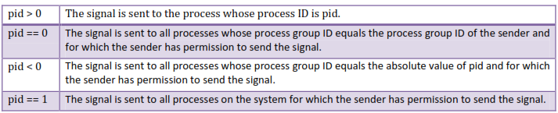
The signal_num argument is the integer value of a signal to be sent to one or more processes designated by pid. The possible values of pid and its use by the kill API are:

Slide 32
The following program illustrates the implementation of the UNIX kill command using the kill API:
#include<iostream.h>
#include<stdio.h>
#include<unistd.h>
#include<string.h>
#include<signal.h>
int main(int argc,char** argv)
{
int pid, sig = SIGTERM;
if(argc==3)
{
if(sscanf(argv[1],”%d”,&sig)!=1)
{
cerr<<”invalid number:” << argv[1] << endl;
return -1;
}
argv++,argc--;
}
while(--argc>0)
if(sscanf(*++argv, “%d”, &pid)==1)
}
{
if(kill(pid,sig)==-1)
perror(“kill”);
}
else
cerr<<”invalid pid:” << argv[0] <<endl;
return 0;

Slide 33
The UNIX kill command invocation syntax is:
Kill [ -<signal_num> ] <pid>......
where signal_num can be an integer number or the symbolic name of a signal. <pid> is process ID.

Slide 34
ALARM
The alarm API can be called by a process to request the kernel to send the SIGALRM signal after a certain number of real clock seconds.
The function prototype of the API is:
#include<signal.h>
Unsigned int alarm(unsigned int time_interval);
Returns: 0 or number of seconds until previously set alarm
The alarm API can be used to implement the sleep API:

Slide 35
#include<signal.h>
#include<stdio.h>
#include<unistd.h>
void wakeup( )
{ ; }
unsigned int sleep (unsigned int timer )
{
}
struct sigaction action;
action.sa_handler=wakeup;
action.sa_flags=0;
sigemptyset(&action.sa_mask);
if(sigaction(SIGALARM,&action,0)==-1)
{
perror(“sigaction”);
return -1;
}
(void) alarm (timer);
(void) pause( );
return 0;

Slide 36
INTERVAL TIMERS
The interval timer can be used to schedule a process to do some tasks at a fixed time interval, to time the execution of some operations, or to limit the time allowed for the execution of some tasks.
The following program illustrates how to set up a real-time clock interval timer using the alarm API:

Slide 37
#include<stdio.h>
#include<unistd.h>
#include<signal.h>
#define INTERVAL 5
void callme(int sig_no)
{
alarm(INTERVAL);
/*do scheduled tasks*/
}
int main()
{
struct sigaction action;
sigemptyset(&action.sa_mask);
action.sa_handler=(void(*)( )) callme; action.sa_flags=SA_RESTART;
if(sigaction(SIGALARM,&action,0)==-1)
{
}
perror(“sigaction”);
return 1;
}
if(alarm(INTERVAL)==-1)
perror(“alarm”);
else while(1)
{
/*do normal operation*/
}
return 0;

Slide 38
In addition to alarm API, UNIX also invented the setitimer API, which can be used to define up to three different types of timers in a process:
▪ Real time clock timer
▪ Timer based on the user time spent by a process
▪ Timer based on the total user and system times spent by a process
The getitimer API is also defined for users to query the timer values that are set by the setitimer API.

Slide 39
The setitimer and getitimer function prototypes are:
#include<sys/time.h>
int setitimer(int which, const struct itimerval * val, struct itimerval * old);
int getitimer(int which, struct itimerval * old);
The which arguments to the above APIs specify which timer to process. Its possible values and the corresponding timer types are:

Slide 40
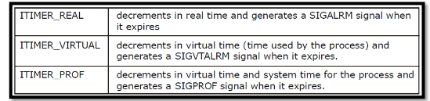

Slide 41
The struct itimerval datatype is defined as:
struct itimerval
{
};
struct timeval it_value; /*current value*/
struct timeval it_interval; /* time interval*/
The setitimer and getitimer APIs return a zero value if they succeed or a -1 value if they fail.

Slide 42
Example program:
#include<stdio.h>
#include<unistd.h>
#include<signal.h>
#define INTERVAL 5
void callme(int sig_no)
{
/*do scheduled tasks*/
}
int main()
{
struct itimerval val;
struct sigaction action;
sigemptyset(&action.sa_mask);
action.sa_handler=(void(*)( )) callme;
action.sa_flags=SA_RESTART;
if(sigaction(SIGALARM,&action,0)==-1)
{
perror(“sigaction”);
return 1;
}

Slide 43
val.it_interval.tv_sec =INTERVAL;
val.it_interval.tv_usec =0;
val.it_value.tv_sec =INTERVAL;
val.it_value.tv_usec =0;
}
if(setitimer(ITIMER_REAL, &val , 0)==-1)
perror(“alarm”);
else while(1)
{
/*do normal operation*/
}
return 0;

Slide 44
POSIX.1b TIMERS
POSIX.1b defines a set of APIs for interval timer manipulations. The POSIX.1b timers are more flexible and powerful than are the UNIX timers in the following ways:
▪ Users may define multiple independent timers per system clock.
▪ The timer resolution is in nanoseconds.
▪ Users may specify the signal to be raised when a timer expires.
▪ The time interval may be specified as either an absolute or a relative time.

Slide 45
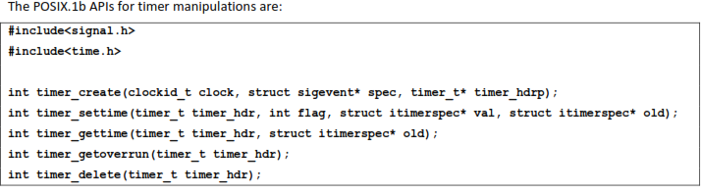

Slide 46
DAEMON PROCESSES
INTRODUCTION
Daemons are processes that live for a long time. They are often started when the system is bootstrapped and terminate only when the system is shut down.
DAEMON CHARACTERISTICS
The characteristics of daemons are:
▪ Daemons run in background.
▪ Daemons have super-user privilege.
▪ Daemons don’t have controlling terminal.
▪ Daemons are session and group leaders.

Slide 47
CODING RULES
▪ Call umask to set the file mode creation mask to 0. The file mode creation mask that's inherited could be set to deny certain permissions. If the daemon process is going to create files, it may want to set specific permissions.
▪ Call fork and have the parent exit. This does several things. First, if the daemon was started as a simple shell command, having the parent terminate makes the shell think that the command is done. Second, the child inherits the process group ID of the parent but gets a new process ID, so we're guaranteed that the child is not a process group leader.
▪ Call setsid to create a new session. The process (a) becomes a session leader of a new session, (b) becomes the process group leader of a new process group, and (c) has no controlling terminal.

Slide 48
▪ Change the current working directory to the root directory. The current working directory inherited from the parent could be on a mounted file system. Since daemons normally exist until the system is rebooted, if the daemon stays on a mounted file system, that file system cannot be unmounted.
▪ Unneeded file descriptors should be closed.
This prevents the daemon from holding open any descriptors that it may have inherited from its parent.

Slide 49
▪ Some daemons open file descriptors 0, 1, and 2 to /dev/null so that any library routines that try to read from standard input or write to standard output or standard error will have no effect.
Since the daemon is not associated with a terminal device, there is nowhere for output to be displayed; nor is there anywhere to receive input from an interactive user. Even if the daemon was started from an interactive session, the daemon runs in the background, and the login session can terminate without affecting the daemon.
If other users log in on the same terminal device, we wouldn't want output from the daemon showing up on the terminal, and the users wouldn't expect their input to be read by the daemon.

Slide 50
Example Program:
#include <unistd,h>
#include <sys/types.h>
#include <fcntl.h>
int daemon_initialise( )
{
pid_t pid;
if (( pid = for() ) < 0)
return –1;
else if ( pid != 0)
exit(0); /* parent exits */
/* child continues */
setsid( );
chdir(“/”);
umask(0);
return 0;
}

